Slide 1
September 2024
Privacy-Preserving Cross-Device Federated Learning Based on Multiparty Homomorphic Encryption with Hierarchical Access Structure
Haowen Liu
Notes:
Hello everyone, today I'm excited to talk about our work on “Privacy-Preserving Cross-Device Federated Learning'.

Slide 2
Table of content
Intro
Background
Refresher: HE and FL
Multiparty Homomorphic Encryption
Proposed MHE with Hierarchical Access Structure
Implementation and Evaluation
Conclusion and Future Work
Notes:
We‘ll dive into the critical question: ”How to preserve privacy while maintain model performance?“ in large-scale federated learning such as IoT networks.
Firstly, we discuss the privacy concerns in current machine learning tasks
"Omniscient Attackers". This means the worst-case scenario where adversary possessing absolute knowledge of our distributed learning system. We question - what if they utilized this complete knowledge to cause the maximum possible disruption?
Next, we'll tackle "Nonlinear Programming Attacks". Here we approach the Byzantine attack problem as an optimization problem, which can be tackled using nonlinear programming techniques. By doing so, we present a principled way to design truly Byzantine attack strategies.
Lastly, we have conducted experiments across different tasks like Mean Estimation, Logistic Regression, and Convolutional Neural Networks. We use them to evaluate the efficacy of our proposed attack strategies compared to existing ones.
Moreover, these findings also shed light on the limitations of current defense mechanisms, and provide valuable insights for future improvements.
Stay with us as we explore these concepts in depth.

Slide 3
Background

Slide 4
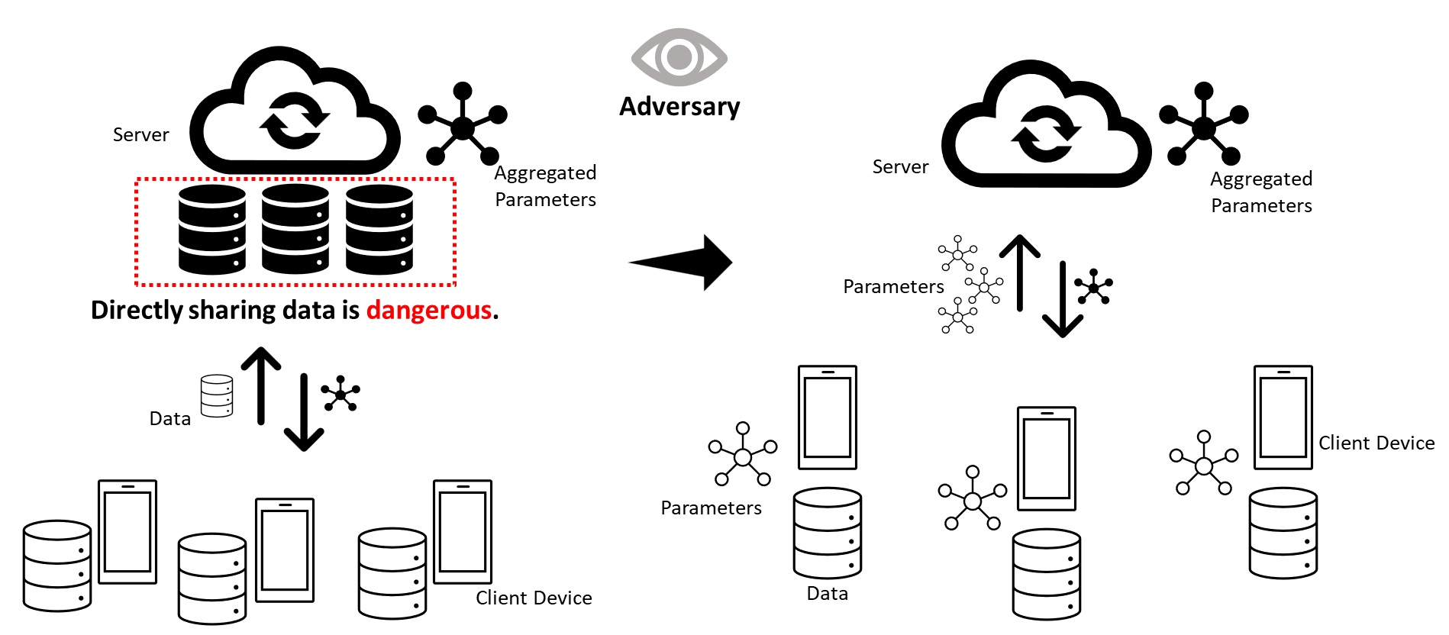
Federated Learning & Data Privacy
Background

Slide 5
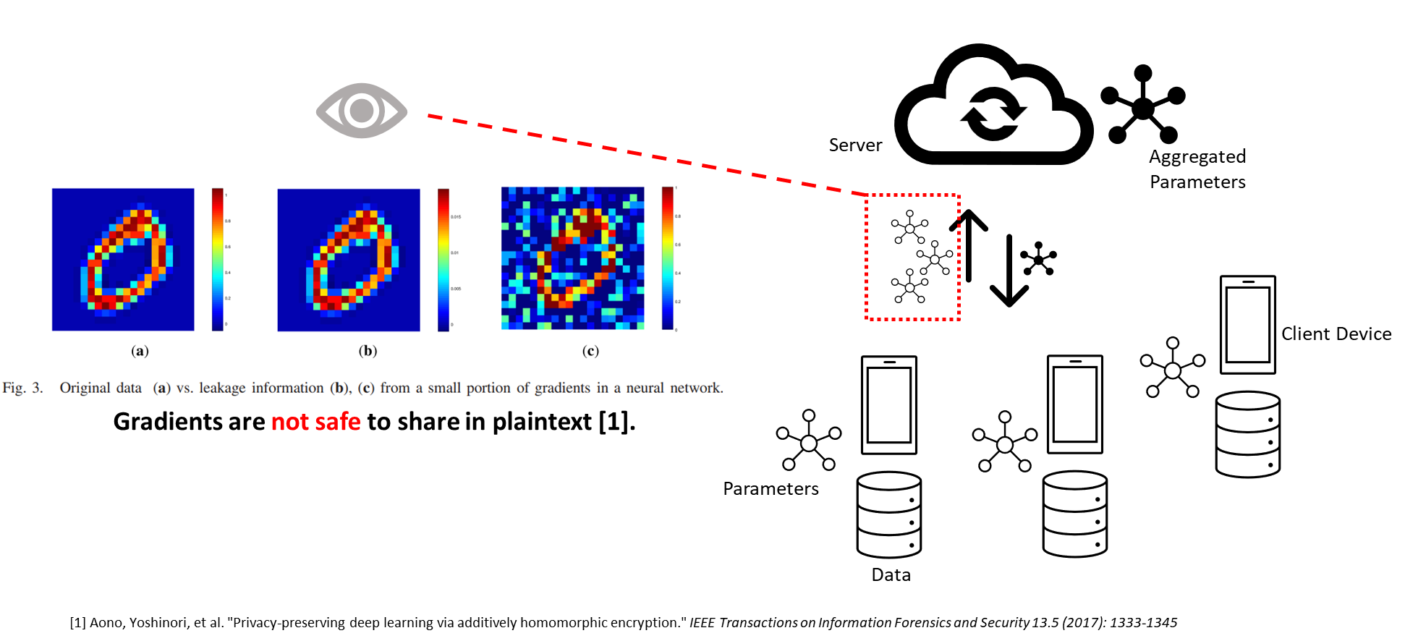
Federated Learning & Data Privacy
Background

Slide 6







Threat Model (Passive) in Federated Learning
Background
The adversary knows the defense and is strategic.
Passive.
Limited collusion possible.
Honest-but-curious server/authority
Insecure communication channel
The only trusted party is yourself
Honest-but-curious clients
[2] Ma, Jing, et al. "Privacy‐preserving federated learning based on multi‐key homomorphic encryption." International Journal of Intelligent Systems 37.9 (2022): 5880-5901.

Slide 7
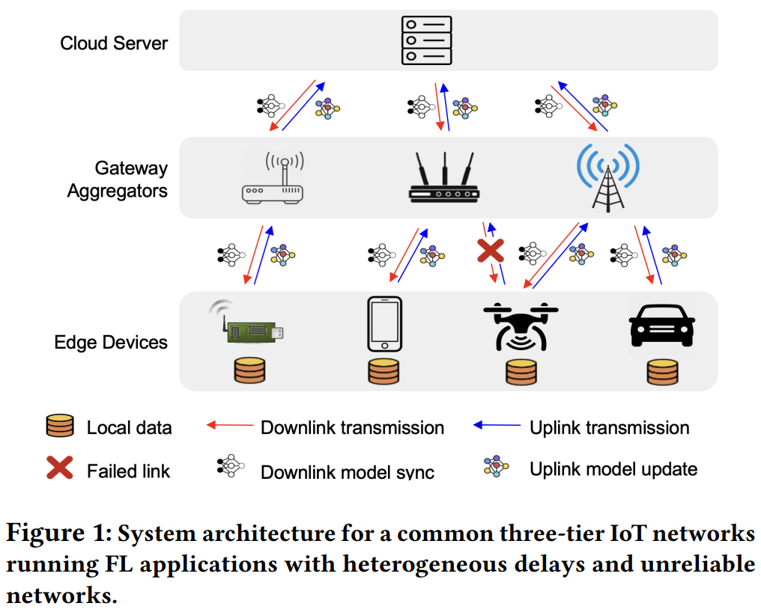
Federated Learning on IoT
Background
Cross-device FL
Large scale of client devices: large data processing and communication cost
Unreliable and heterogeneous networks: heterogeneous delays and dropouts
[4] Yu, Xiaofan, et al. "Async-HFL: Efficient and robust asynchronous federated learning in hierarchical IoT networks." Proceedings of the 8th ACM/IEEE Conference on Internet of Things Design and Implementation. 2023.

Slide 8
Privacy-Preserving Federated Learning
Background
Method | Differential Privacy | Secure MPC | Secure Aggregation | Homomorphic Encryption
Efficiency | yes
Strong privacy |  | yes |  | yes
No accuracy loss |  | yes | yes | yes
We will focus on HE to acquire better privacy.
[3] Zhang, Chengliang, et al. Presentation of "{BatchCrypt}: Efficient homomorphic encryption for {Cross-Silo} federated learning." 2020 USENIX annual technical conference (USENIX ATC 20). 2020.

Slide 9
HE and FL Basics

Slide 10
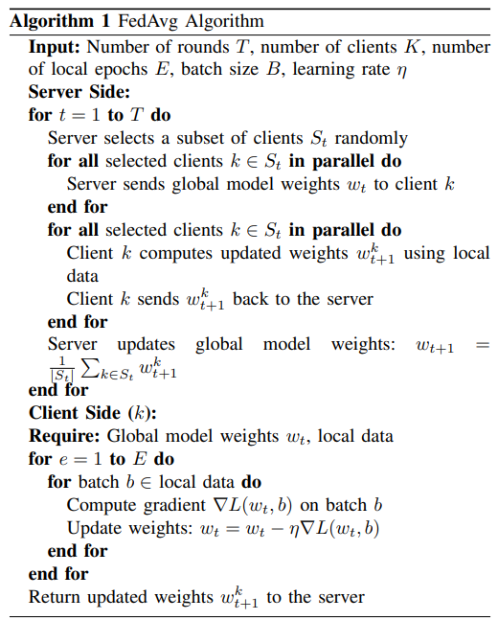
Federated Learning
Mathematical background
Server
Aggregated Parameters
Parameters
Client Device
Parameters
Data

Slide 11
Homomorphic Encryption
Mathematical background
Homomorphic Encryption (HE) allows for computations to be performed on ciphertexts, generating an encrypted result which, when decrypted, matches the result of operations performed on the plaintext.
Partially-Homomorphic: Paillier
Fully-Homomorphic: RLWE (BFV, CKKS, …)

Slide 12
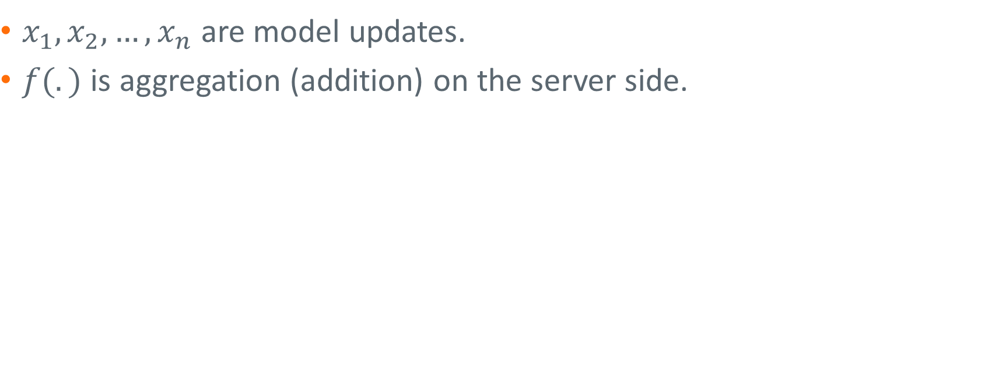
HE + FL
Mathematical background
$x_{1}, x_{2}, …, x_{n}$ are model updates.
$f(.)$ is aggregation (addition) on the server side.

Slide 13
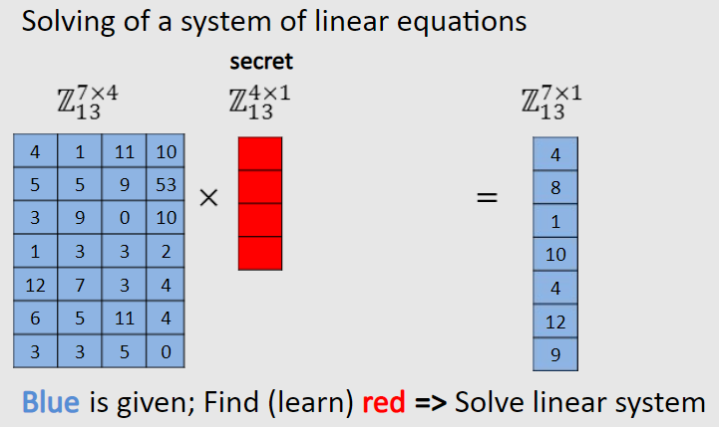
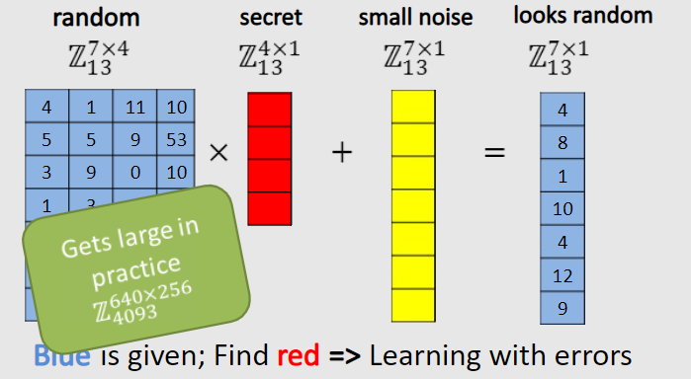

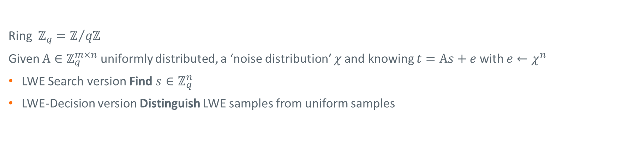


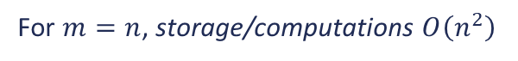

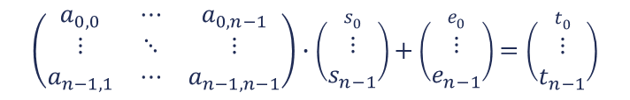
Learning With Error Problem (LWE)
Mathematical background
$A$, $t$ known
$s,e$secret
Ring $ℤ_{q}=ℤ/{qℤ}$
Given $A∈ℤ_{q}^{m×n}$ uniformly distributed, a ‘noise distribution’ $χ$ and knowing $t=As+e$ with $e←χ^{n}$
LWE Search version Find $s∈ℤ_{q}^{n}$
LWE-Decision version Distinguish LWE samples from uniform samples
A
s
t
A
s
e
t
$$\left(\begin{matrix}a_{0,0} & ⋯ & a_{0,n−1} \\ ⋮ & ⋱ & ⋮ \\ a_{n−1,1} & ⋯ & a_{n−1,n−1}\end{matrix}\right)∙\left(\begin{aligned}s_{0} \\ ⋮ \\ s_{n−1}\end{aligned}\right)+\left(\begin{aligned}e_{0} \\ ⋮ \\ e_{n−1}\end{aligned}\right)=\left(\begin{aligned}t_{0} \\ ⋮ \\ t_{n−1}\end{aligned}\right)$$
=
+
=
$$Easy$$
$$Hard$$
For $m=n$, storage/computations $O\left(n^{2}\right)$
Ref. RWC’15 Douglas Stebila)

Slide 14
Multiparty Homomorphic Encryption

Slide 15
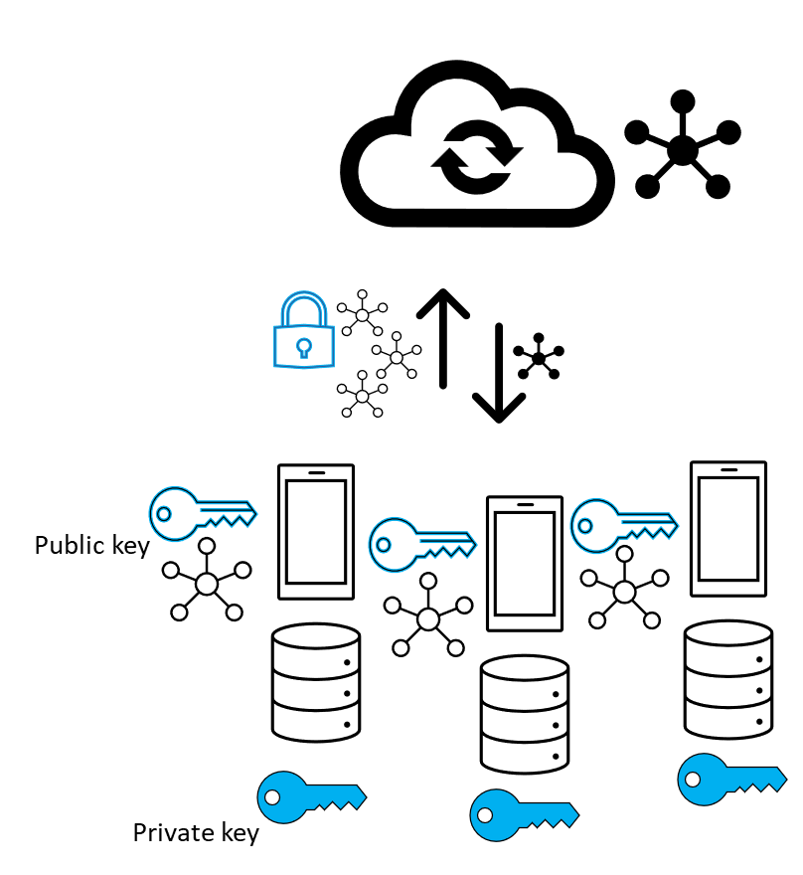
Plain Multiparty Homomorphic Encryption
MHE
Using common public key and private key for encryption and decryption.

Slide 16
Plain Multiparty Homomorphic Encryption
MHE
Pros:
Simple scheme and easy to implement.
Low overhead during setup.
Cons:
Weak threat model (e.g., server and one client can collude to break).
Single-point failure

Slide 17
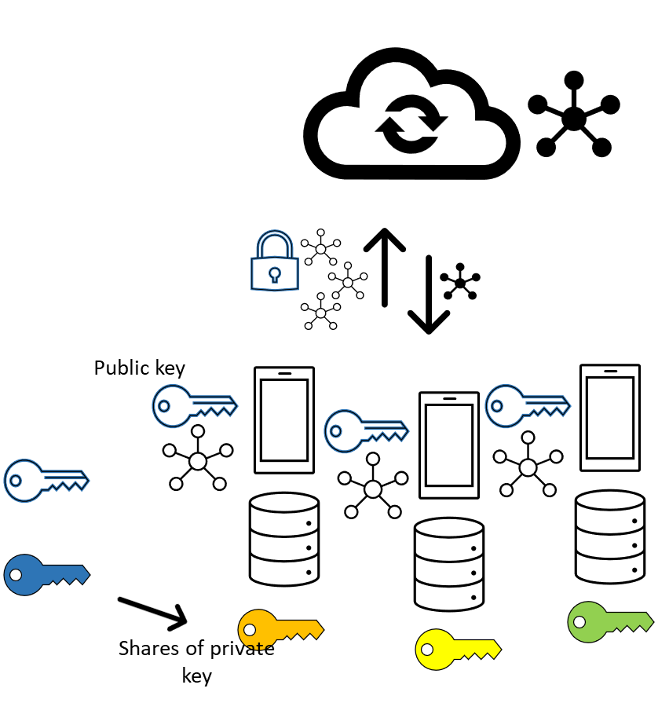
Fully-Multiparty Homomorphic Encryption
MHE
Each party holds a local private key (can be seen as a share of the unrevealed global private key), and all parties collectively generate the global public key.
Using the global public key for encryption. Collectively decrypting ciphertexts using local private keys.
[5] Mouchet, Christian, et al. "Multiparty homomorphic encryption from ring-learning-with-errors." Proceedings on Privacy Enhancing Technologies 2021.CONF (2021): 291-311.z

Slide 18
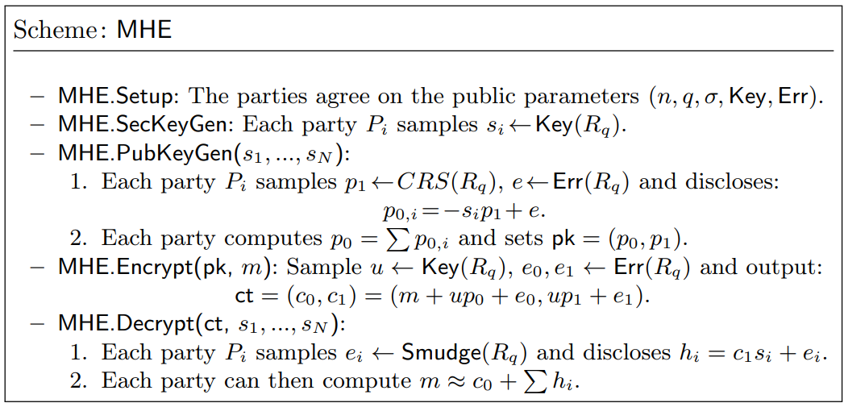
FMHE: An example implementation
MHE
[6] Mouchet, Christian, Elliott Bertrand, and Jean-Pierre Hubaux. "An efficient threshold access-structure for rlwe-based multiparty homomorphic encryption." Journal of Cryptology 36.2 (2023): 10.

Slide 19
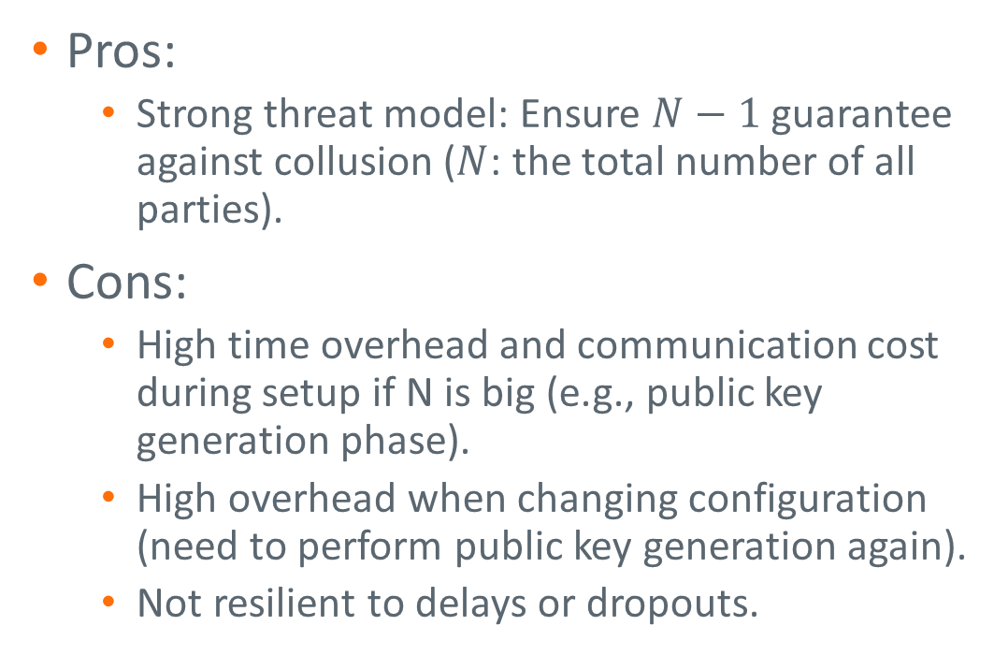
Fully-Multiparty Homomorphic Encryption
MHE
Pros:
Strong threat model: Ensure $N−1$ guarantee against collusion ($N$: the total number of all parties).
Cons:
High time overhead and communication cost during setup if N is big (e.g., public key generation phase).
High overhead when changing configuration (need to perform public key generation again).
Not resilient to delays or dropouts.

Slide 20
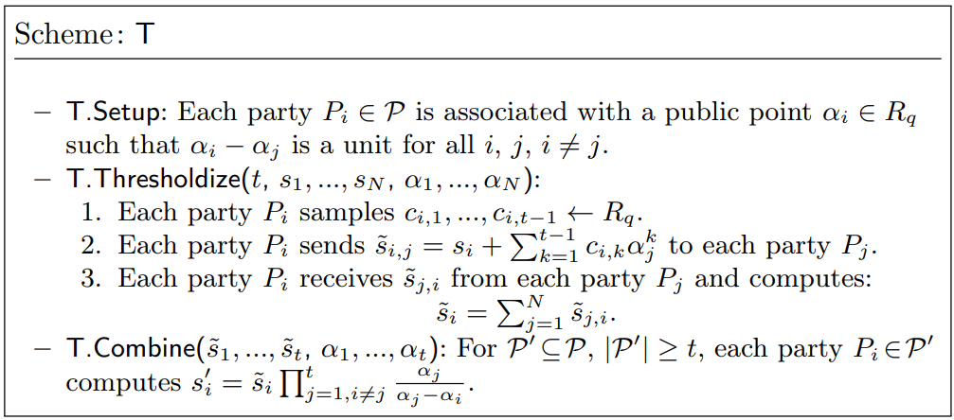
Share-resharing: for setting up threshold
MHE
[6] Mouchet, Christian, Elliott Bertrand, and Jean-Pierre Hubaux. "An efficient threshold access-structure for rlwe-based multiparty homomorphic encryption." Journal of Cryptology 36.2 (2023): 10.

Slide 21

Share-resharing: for setting up threshold
MHE
Share resharing
Required parties during decryption: N
Required parties during decryption: T

Slide 22
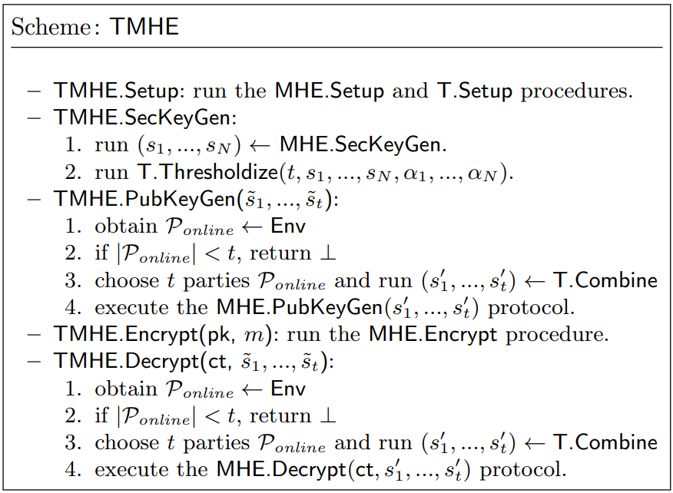
TMHE: Flexible access structure
MHE
[6] Mouchet, Christian, Elliott Bertrand, and Jean-Pierre Hubaux. "An efficient threshold access-structure for rlwe-based multiparty homomorphic encryption." Journal of Cryptology 36.2 (2023): 10.

Slide 23
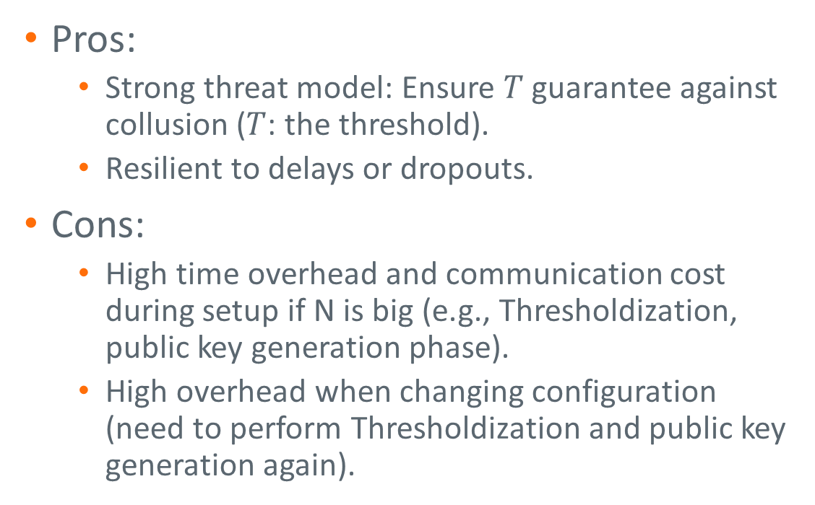
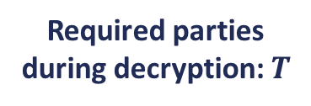
TMHE: Flexible access structure
MHE
Pros:
Strong threat model: Ensure $T$ guarantee against collusion ($T$: the threshold).
Resilient to delays or dropouts.
Cons:
High time overhead and communication cost during setup if N is big (e.g., Thresholdization, public key generation phase).
High overhead when changing configuration (need to perform Thresholdization and public key generation again).
Required parties during decryption: $T$

Slide 24
H-MHE: Hierarchical and Hybrid Access Structure

Slide 25
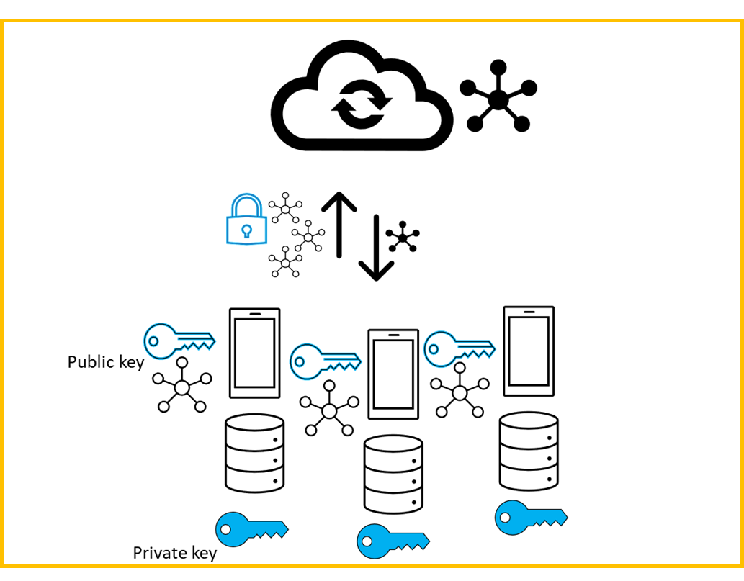
PMHE
H-MHE
Enc(.)
Common public key
Plaintext
Ciphertext
Plaintext
Ciphertext
Common private key
Dec(.)

Slide 26

Plain HE: Look from a higher level
H-MHE
Common public key
Enc(.)
Plaintext
Ciphertext
Plaintext
Ciphertext
Dec(.)
Common private key
Same function as a single device (Enc and Dec)!

Slide 27
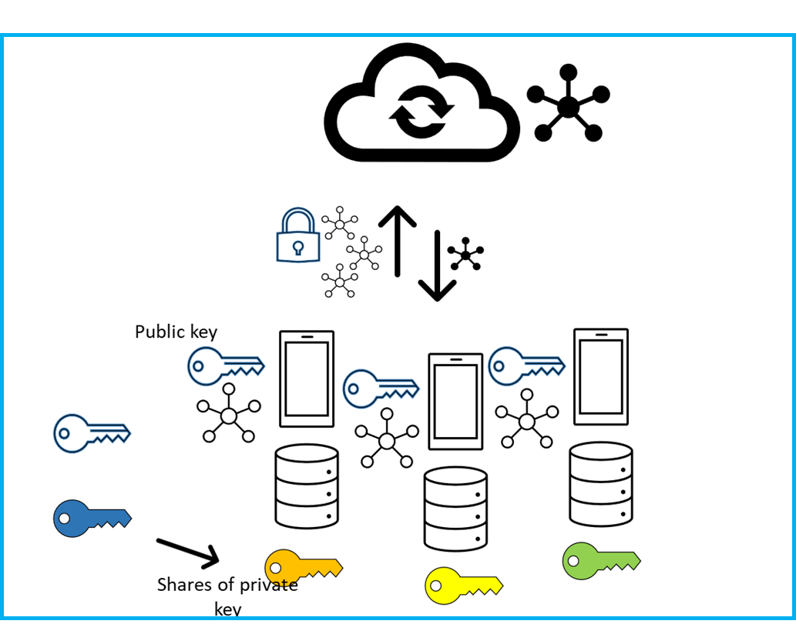
TMHE
H-MHE
Enc(.)
Collective public key
Plaintext
Ciphertext
Plaintext
Ciphertext
Collective private key
Dec(.)

Slide 28

TMHE: Look from a higher level
H-MHE
Collective public key
Enc(.)
Plaintext
Ciphertext
Plaintext
Ciphertext
Dec(.)
Collective private key
Same function as a single device (Enc and Dec)!

Slide 29
TMHE: Flexible Access Structure
H-MHE
?
What if abstracted devices continue to communicate with a higher-layer server, as real devices communicate with their server in a MHE system?
Abstraction
Plain HE system
Abstracted Device
A server at a higher layer
Abstraction
TMHE system
Abstracted Device

Slide 30

H-MHE: Hierarchical and Hybrid Access Structure
H-MHE
MHE system
A server at a higher layer
Plain HE subsystem (cluster)
TMHE subsystem (cluster)
Abstraction
Abstraction
Abstracted Devices
Abstracted Devices

Slide 31
H-MHE: Perfectly adapted to Hierarchical FL among large-scale devices
H-MHE

Slide 32
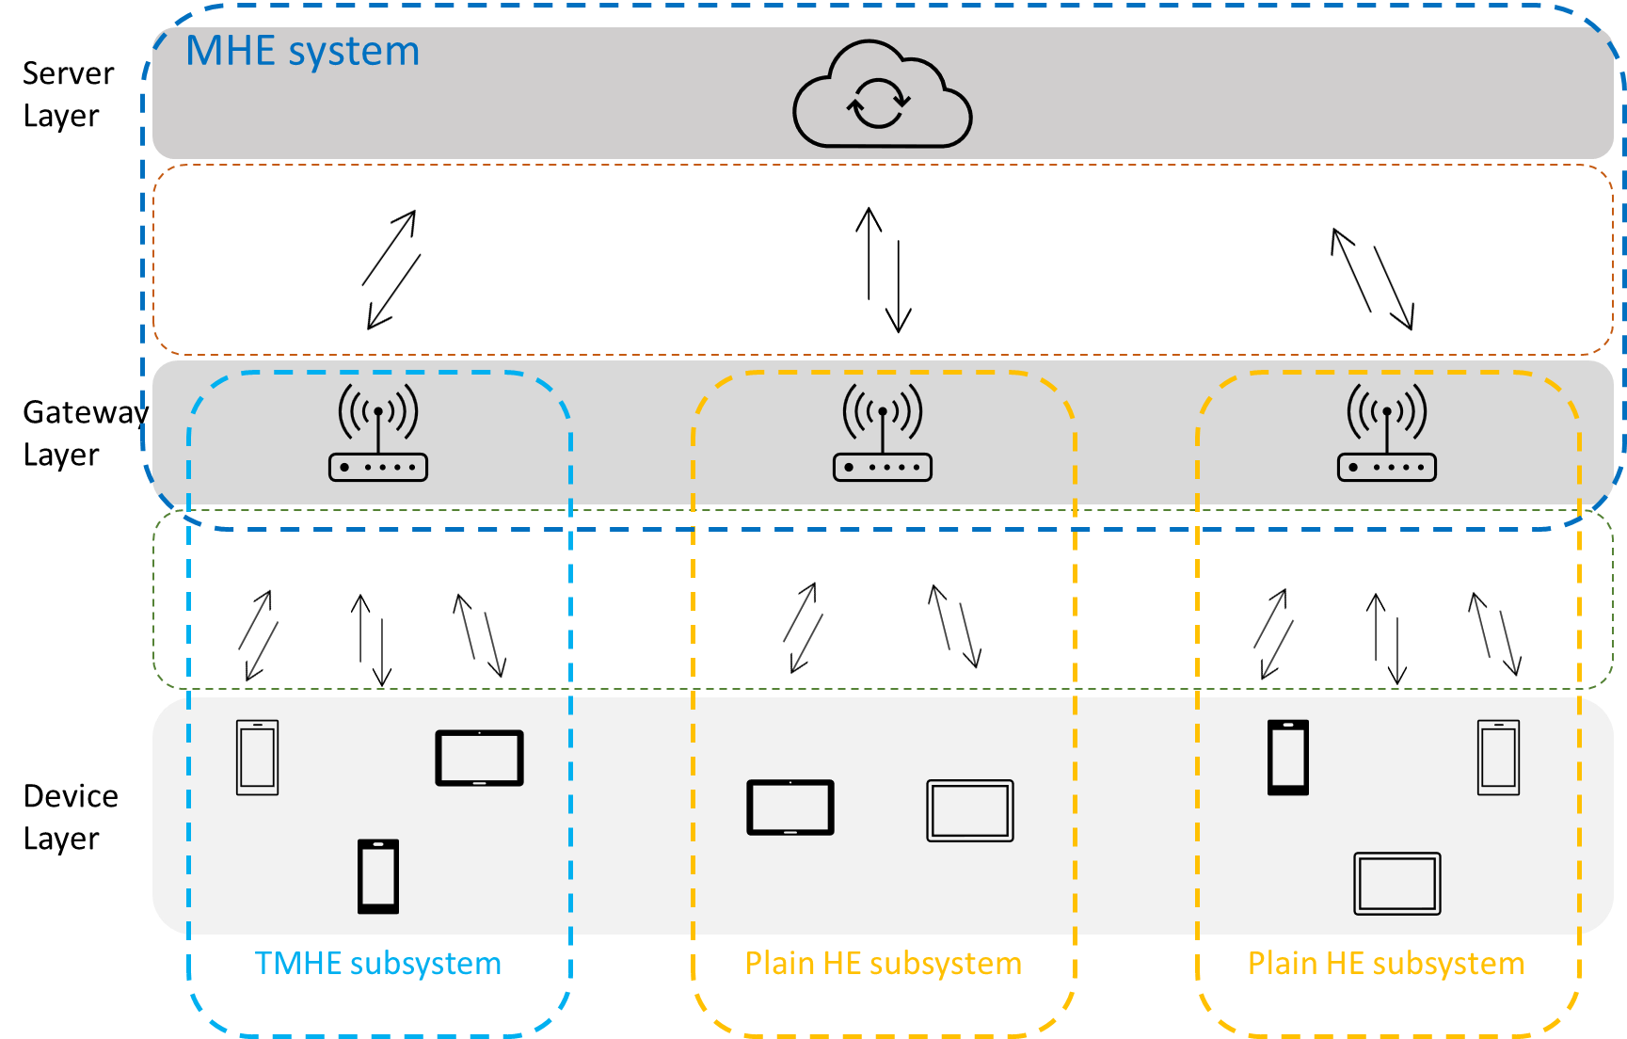
H-MHE + HFL
H-MHE

Slide 33
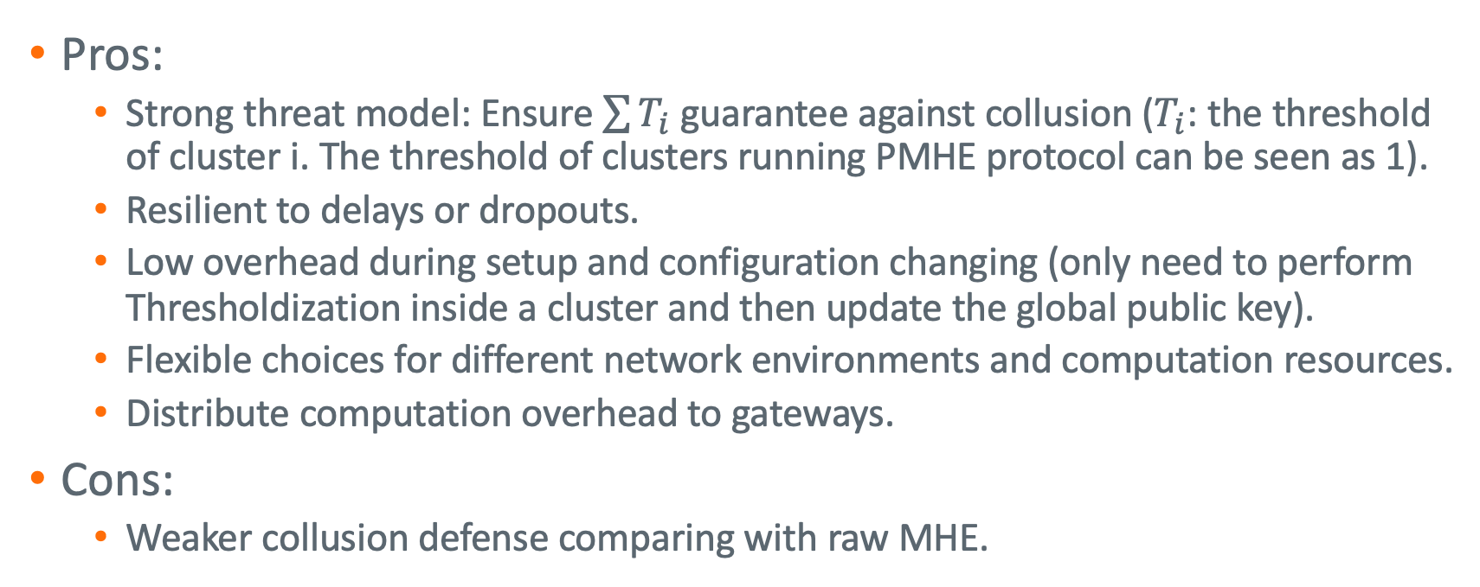
H-MHE: Hierarchical and Hybrid Access Structure
H-MHE
Pros:
Strong threat model: Ensure $\sum{T_{i}}$ guarantee against collusion ($T_{i}$: the threshold of cluster i. The threshold of clusters running PMHE protocol can be seen as 1).
Resilient to delays or dropouts.
Low overhead during setup and configuration changing (only need to perform Thresholdization inside a cluster and then update the global public key).
Flexible choices for different network environments and computation resources.
Distribute computation overhead to gateways.
Cons:
Weaker collusion defense comparing with raw MHE.

Slide 34
Implementation

Slide 35
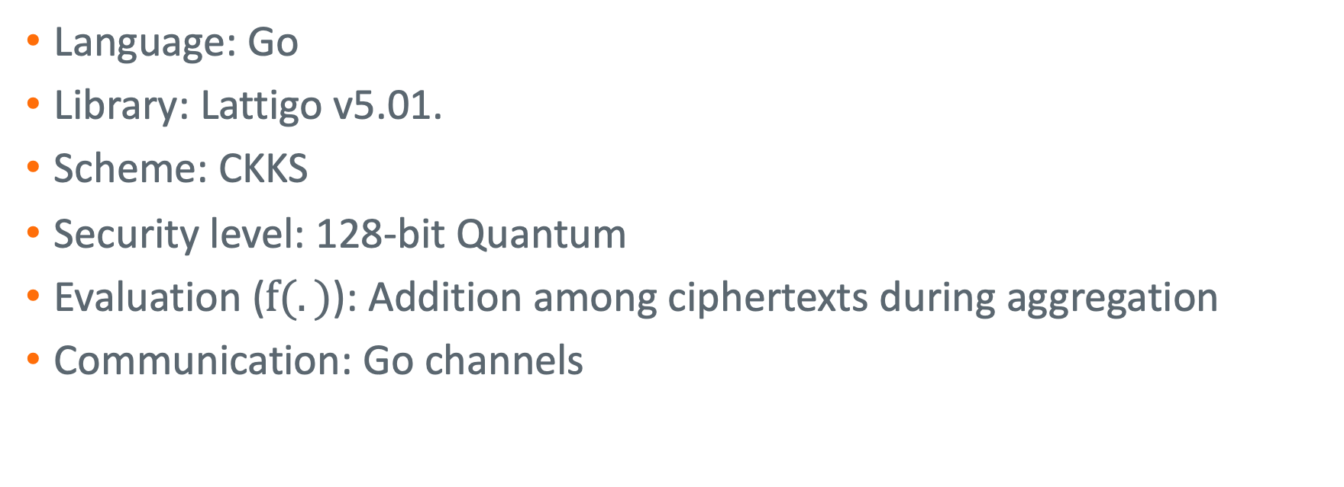
Cryptosystem
Implementation
Language: Go
Library: Lattigo v5.01.
Scheme: CKKS
Security level: 128-bit Quantum
Evaluation ($f(.)$): Addition among ciphertexts during aggregation
Communication: Go channels

Slide 36
Federated Learning
Implementation
Language: Go
Library: modified Go-deep.
Dataset: MNiST
Networks: MLP with 2 fully-connected layers (~40,000 parameters)
Training: batch training
Communication: Go channels

Slide 37
Evaluation

Slide 38
Heterogeneity and Unreliability
Network Simulation
Category # | Average dropout rate | Number of devices | Threshold of H-MHE clusters
1 | 0.5 | 25 | 4
2 | 0.2 | 25 | 9
3 | 0.05 | 25 | 17
4 | 0.01 | 25 | 20
Sum | - | 100 | 50

Slide 39
Results
Evaluation
Scheme | Accuracy | Setup time (s) | Training time (s) | Number of Failure Rounds
None | 0.930 | 0 | 189.0 | 0
PMHE | 0.926 | 0.0559 | 564.5 | 0
FMHE | 0.110 | 1.52 | 628.8 | 320
TMHE | 0.926 | 70.18 | 1043.2 | 0
H-MHE | 5.73 | 5.73 | 916.3 | 0.2

Slide 40
Resilience, performance, overhead, and scalability
Evaluation
Resilience to dropouts. From experimental results we notice that with an approperiate arrange- ment for cluster thresholds in H-MHE, H-MHE can achieve asymptotic dropout resilience as TMHE, PMHE, and even raw FL.
No accuracy drop. In our experimental results we only detect negligible accuracy drop in H-MHE in comparison with raw FL, which can be the cause of randomness.
Significant speedup during setup and training process. We detect 12.25× speedup during cryp- tosystem setup phase and 1.14× speedup during training process in comparison with TMHE, which is a big advancement.
Scalability. We also notice in our experiment that the time overhead and communication cost are only related to the size of the biggest cluster in H-MHE system. So as long as we constrain the size of clusters, and only add more clusters but not enlarge existing clusters when there are more devices, H-MHE can always maintain good efficiency. However, the time of TMHE grows quadratically with the size of the network.

Slide 41
Conclusion

Slide 42
Conclusion
Conclusion
Novelty: the first trial to apply MHE to hierarchical federated learning and cross-device federated learning.
Bridge the gap between HE schemes and cross-silo FL with IoT-specific challenges: 1) large scale; 2) heterogeneity; 3) unreliability; 4) low overhead
Showing good advantages in terms of resilience, performance, overhead, and scalability compared with SOTA HE schemes.

Slide 43
Future work
Conclusion
Integrating Differential Privacy (DP) techniques with the H-MHE protocol
Exploring more efficient cryptographic primitives or leveraging advances in hardware acceleration
Software engineering aspects required to transition from a prototype to a production-ready system
Evaluating H-MHE framework in real IoT scenarios

Slide 44
Questions?
Thanks!

